Slide 1
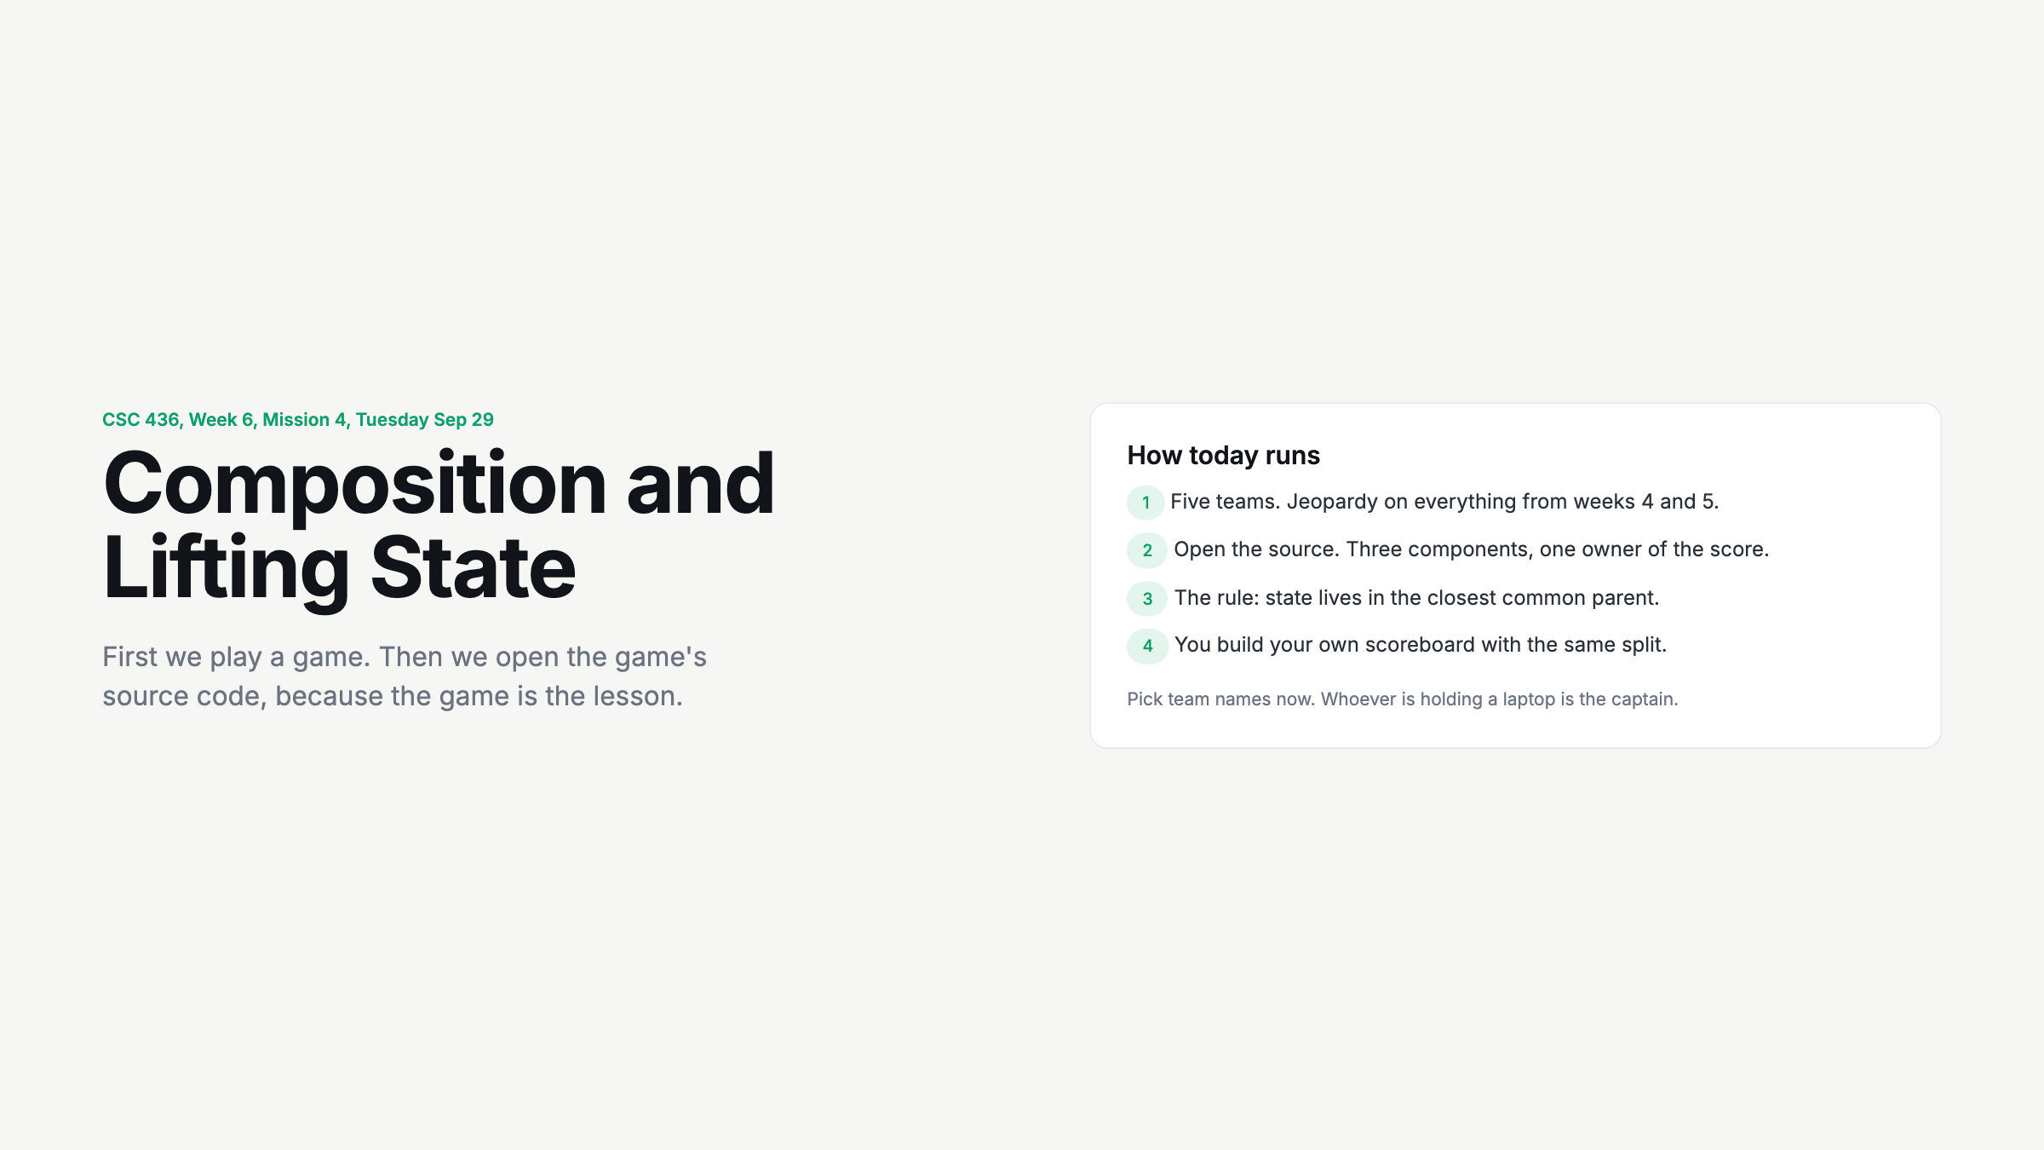
Notes:
Split into five teams of five or six before anything else. Captains have the laptop. Team names go into the scoreboard on the next slide.

Slide 2
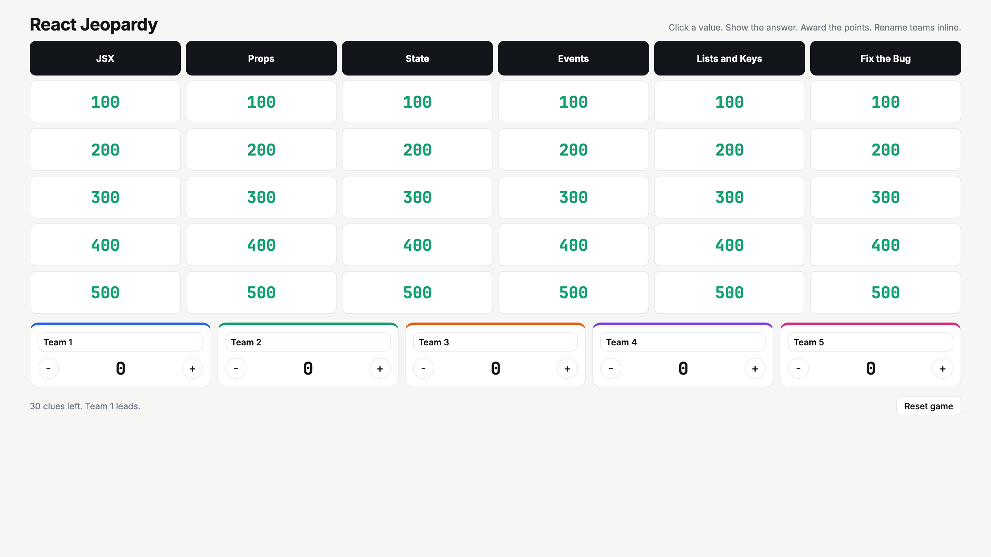
Notes:
Run about 25 minutes. Rename teams inline. Click a value, read it, teams write answers, show answer, award. Minus buttons exist for wrong buzzes if you want them. Arrow keys are disabled while a clue is open. Leave the board unfinished and come back at the close.

Slide 3
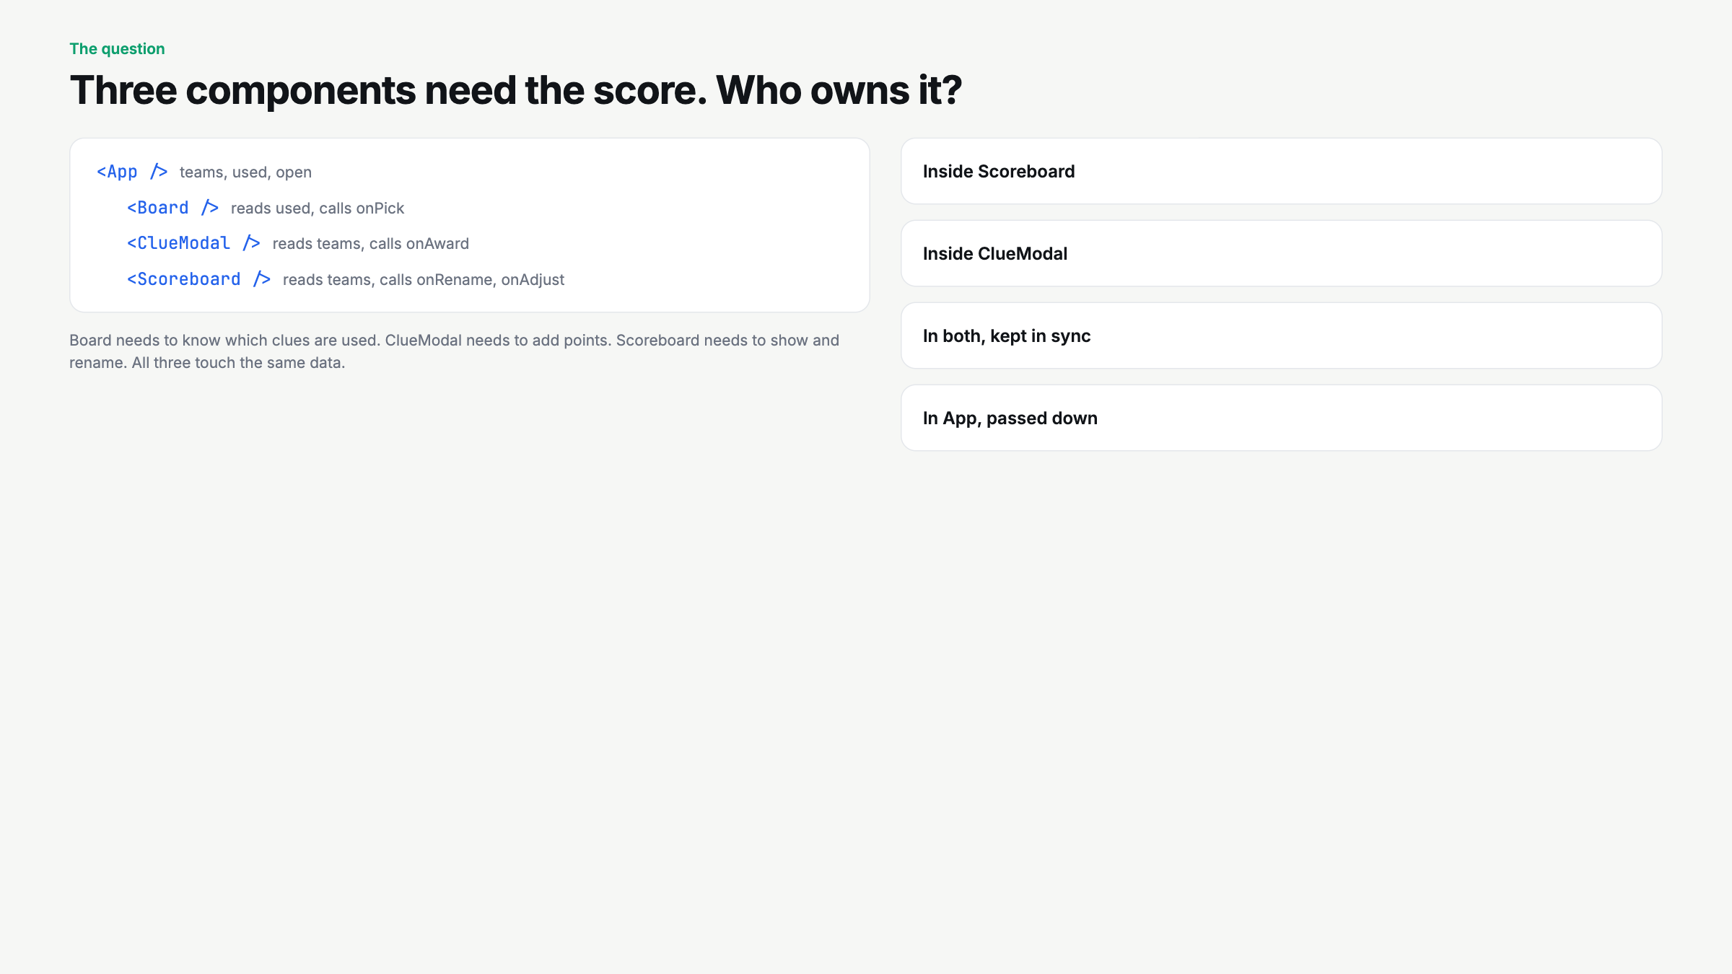
Notes:
Do not reveal. Vote by hand on the four options, then click each one in order. Save App for last. Say the rule twice: closest common parent.

Slide 4
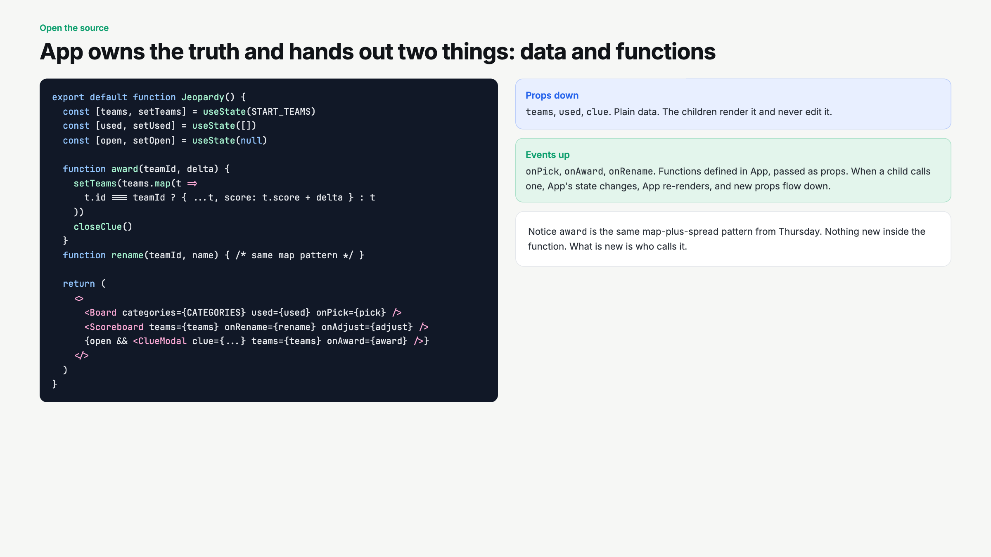
Notes:
Open src/Jeopardy.jsx in the editor alongside. Point at the real award function. Props down, events up. Write those three words on the board.

Slide 5
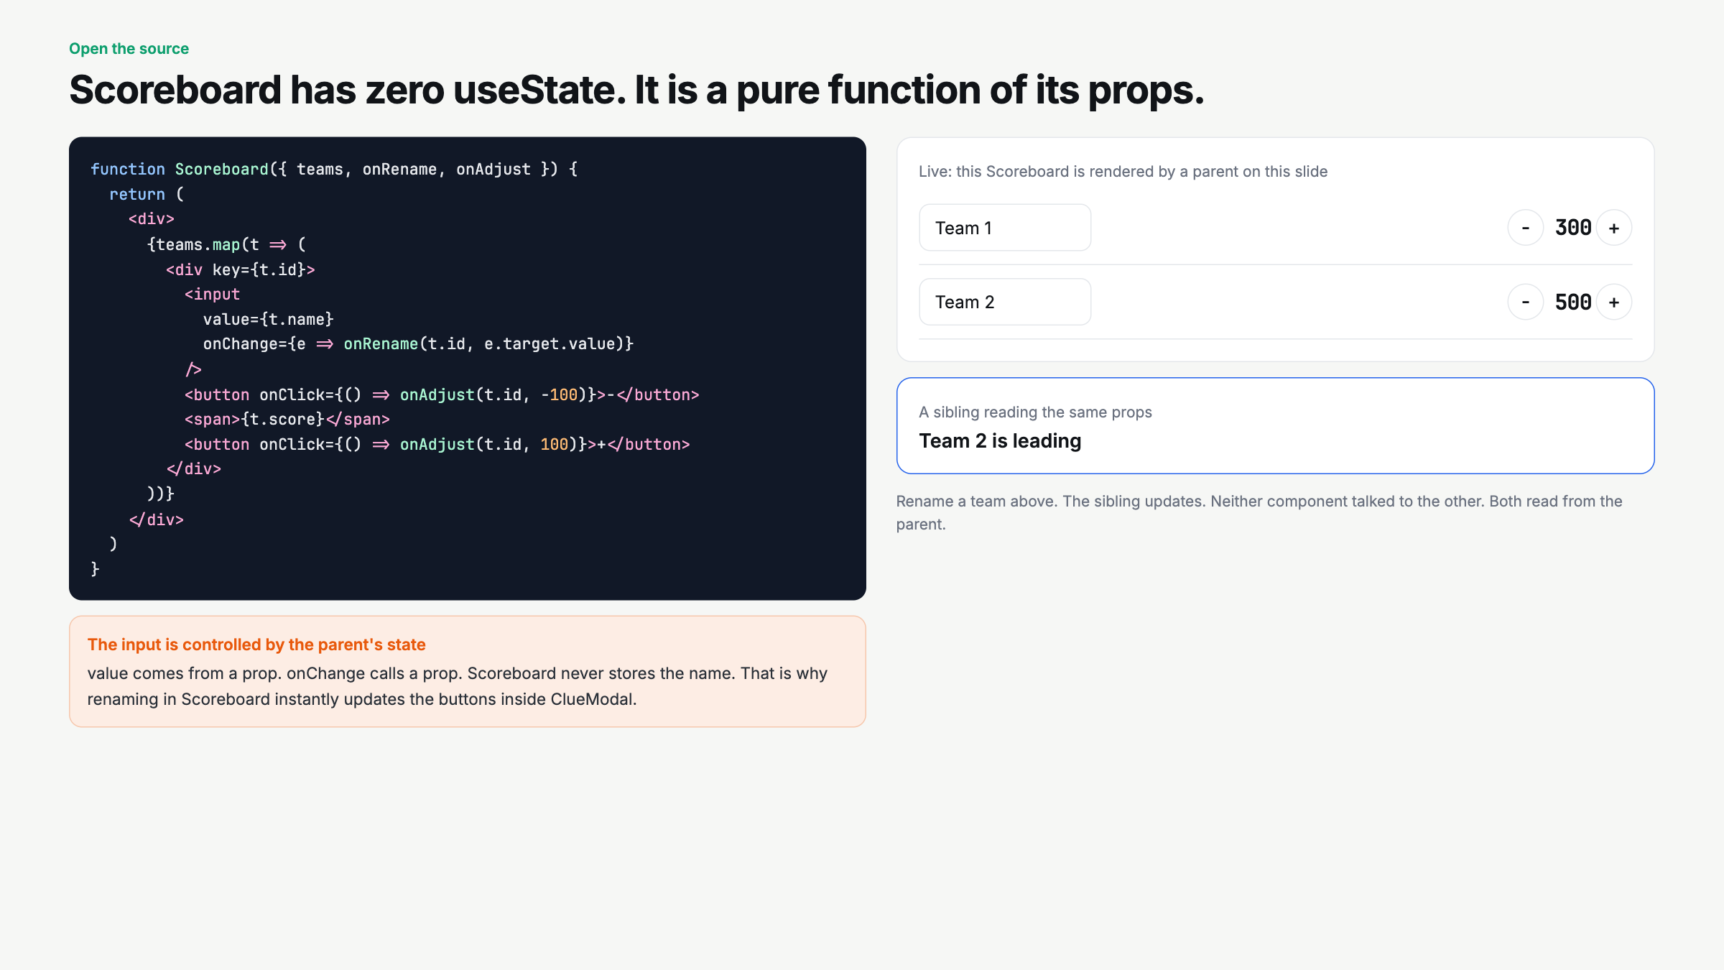
Notes:
Rename a team on the live demo and point at the sibling updating. Ask: how many useState calls are in Scoreboard? Zero.

Slide 6
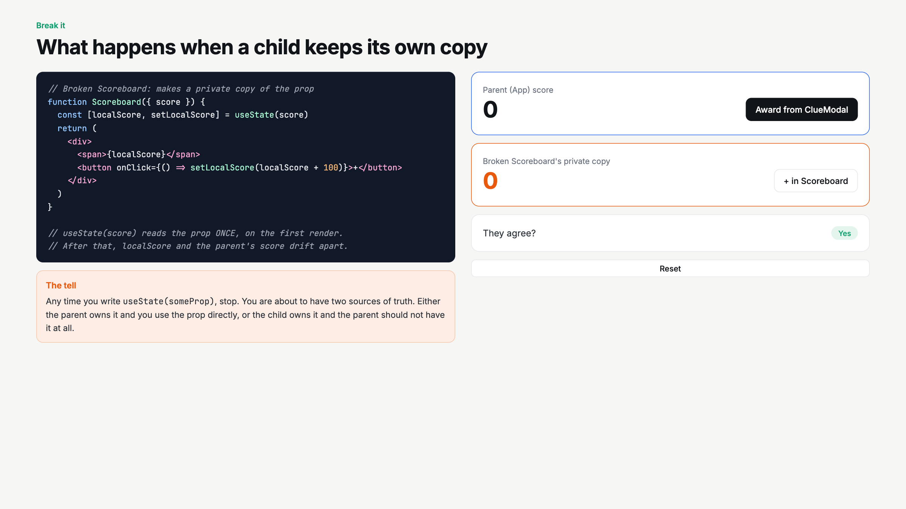
Notes:
Deliberate mistake beat. Click Award from ClueModal three times, then + in Scoreboard once. They disagree. The tell: useState(someProp). Say it.

Slide 7
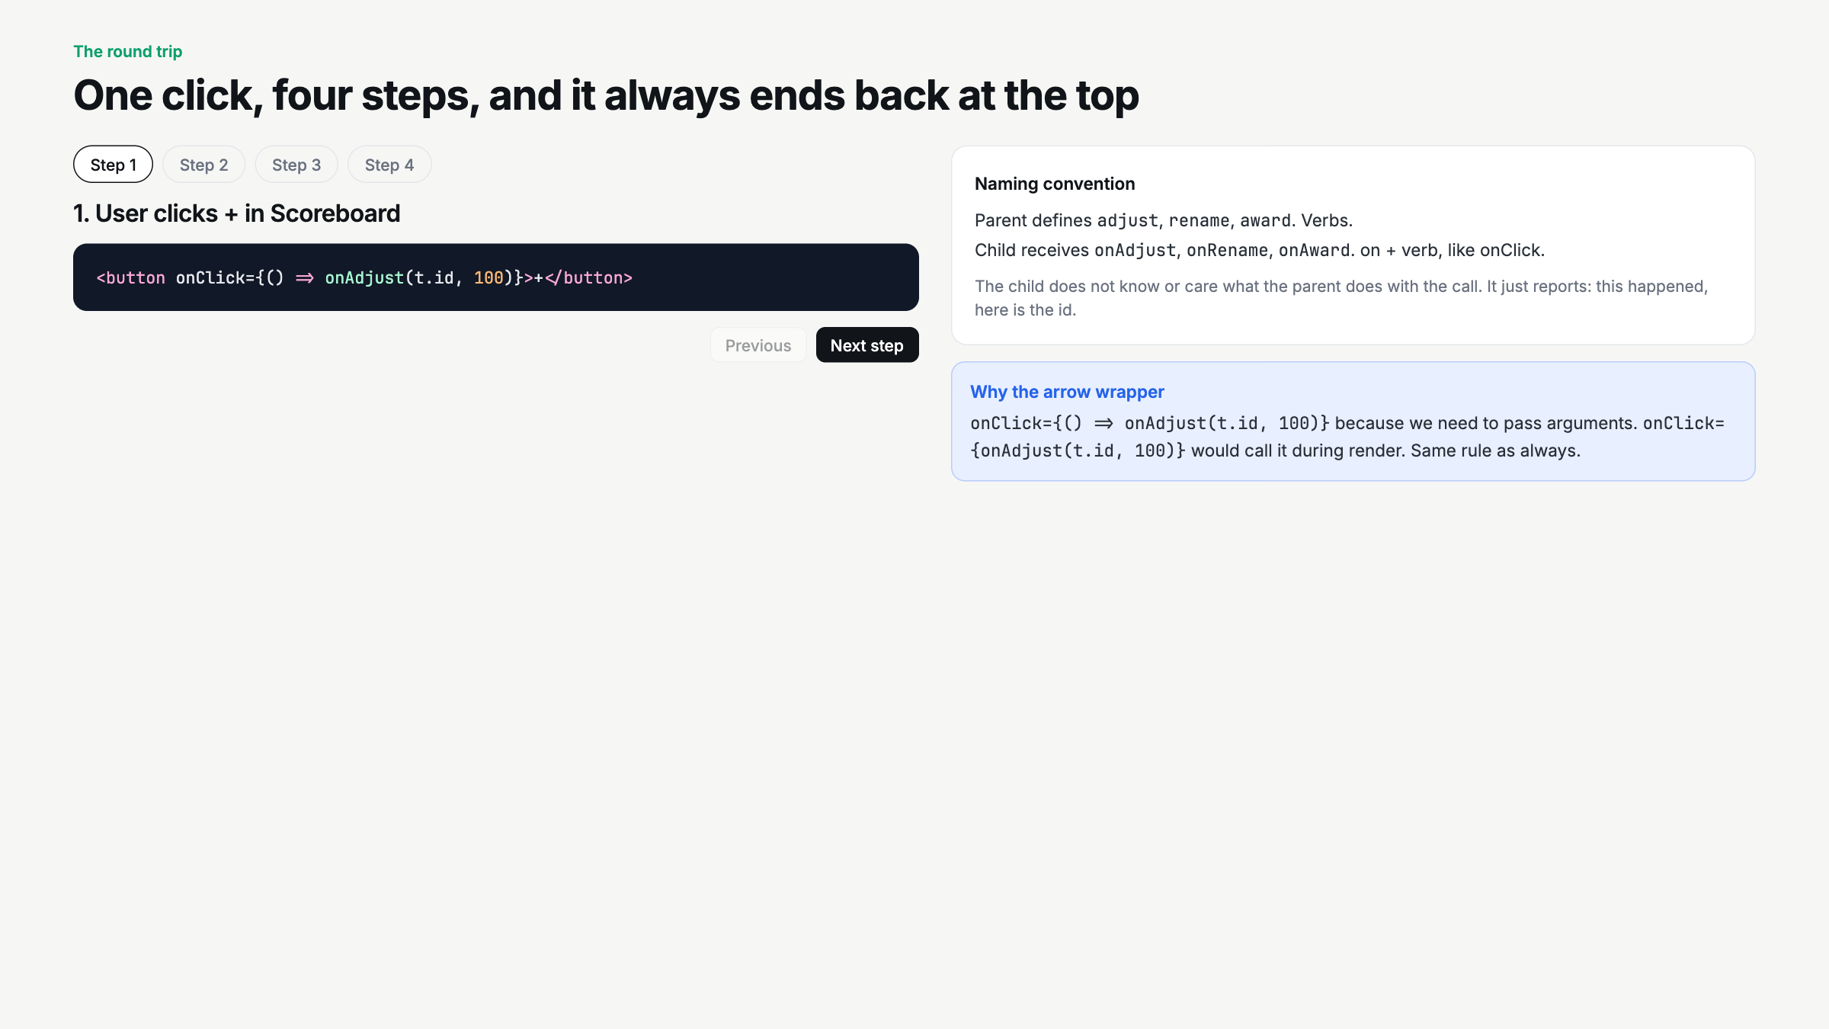
Notes:
Walk the four steps slowly. The point is the loop always returns to App. Naming: verbs in the parent, on plus verb in the child.

Slide 8
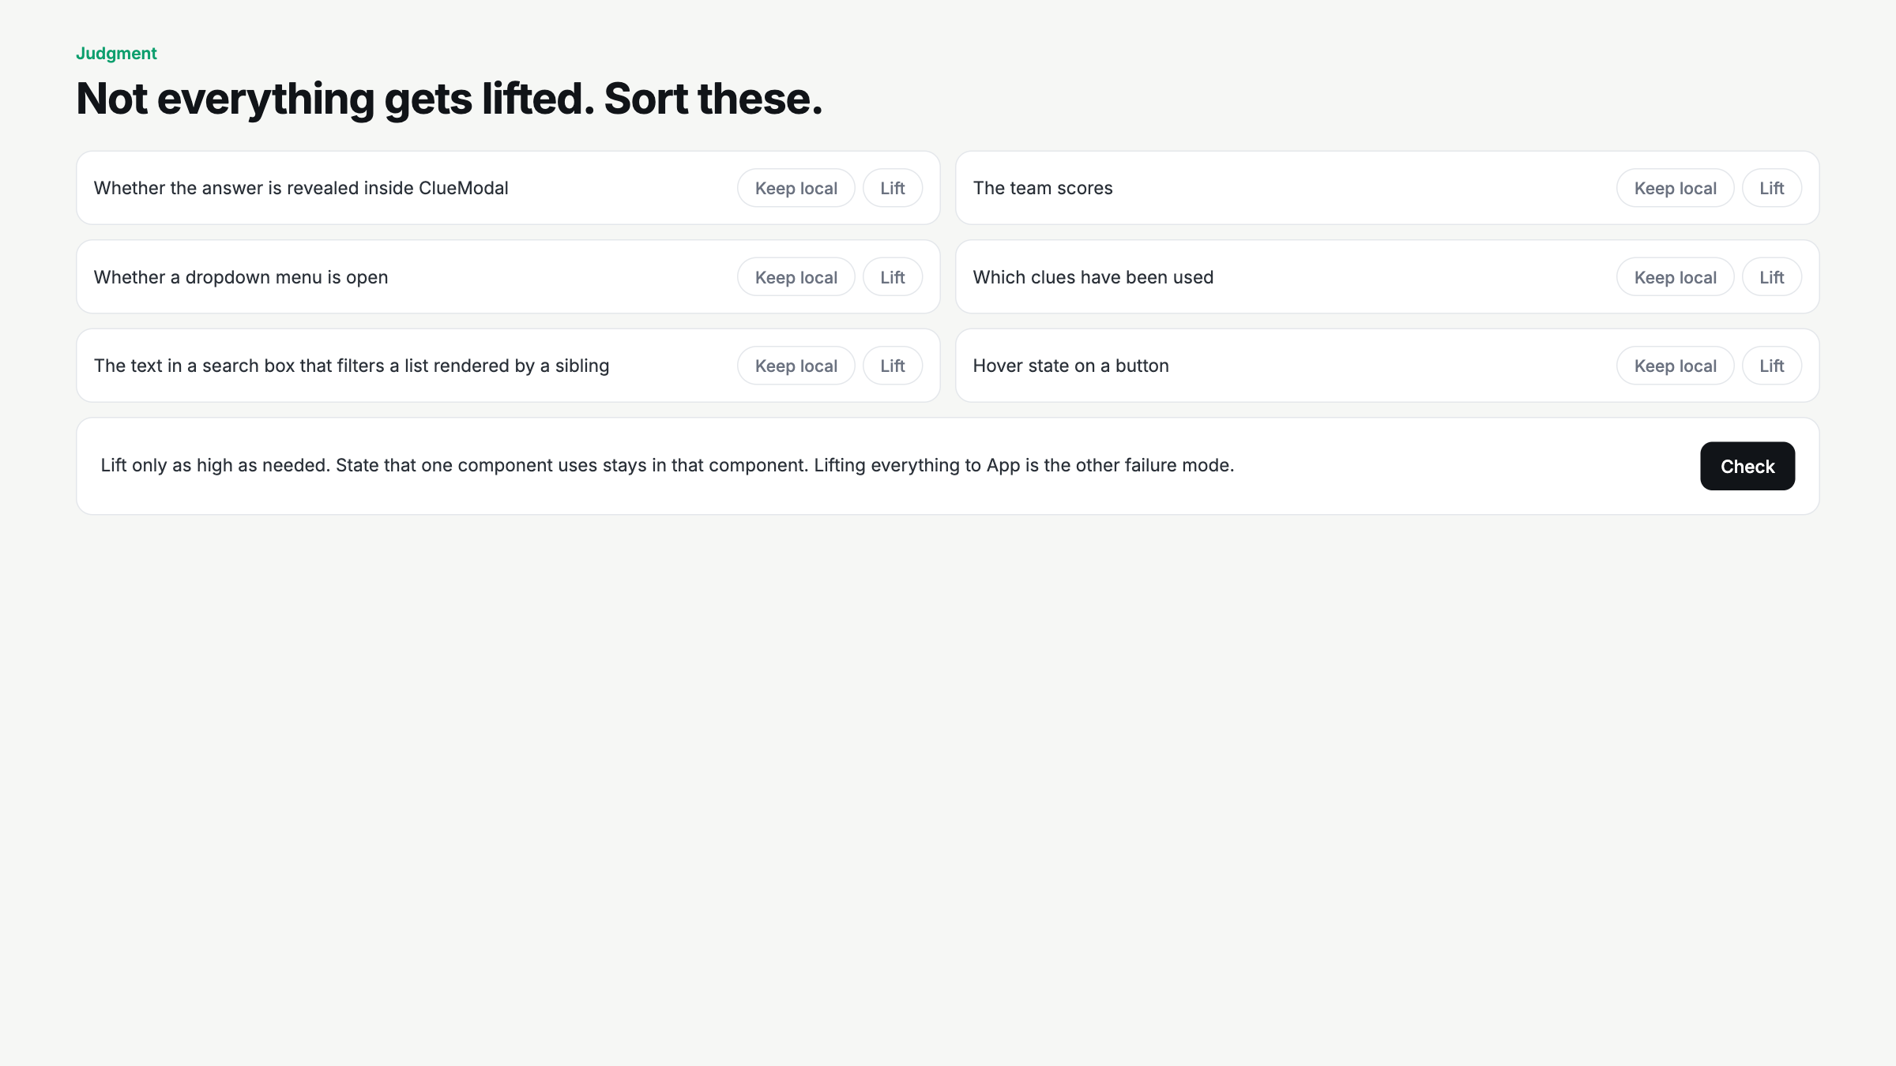
Notes:
Vote per card before Check. The reveal toggle and hover are the ones that catch over-lifters. Lift only as high as needed.

Slide 9
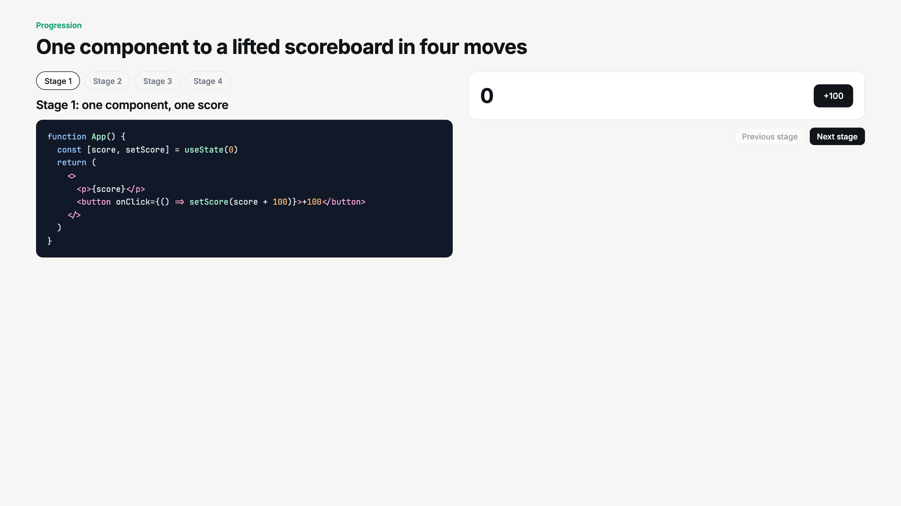
Notes:
Live-code script. Stage 1 to 4. At stage 3, write onClick={onAward(amount)} on purpose and watch it fire on render. Fix with the arrow.

Slide 10
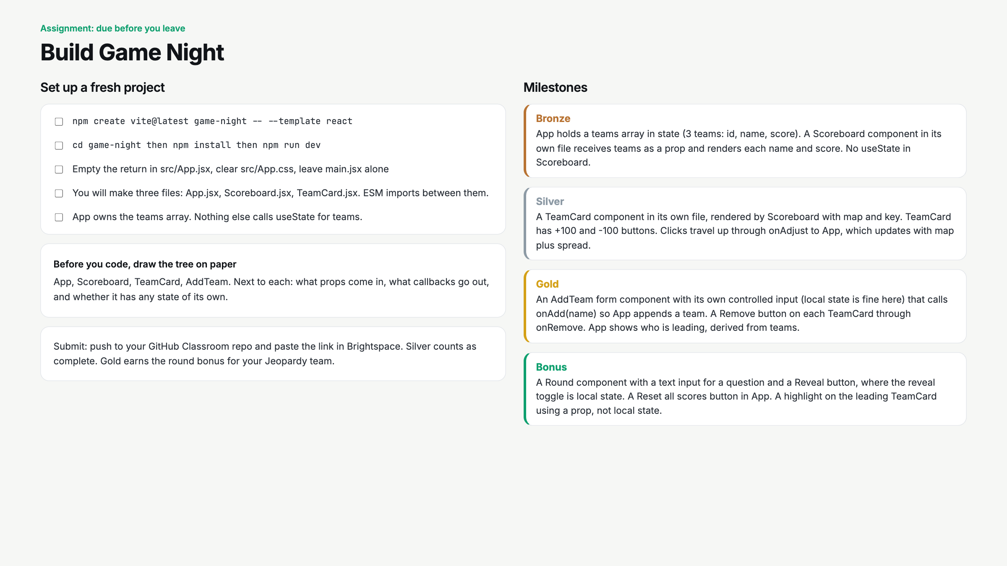
Notes:
Paper tree first, no exceptions. Start a 25 minute timer. Circulate for useState(props.x) and for useState in Scoreboard.

Slide 11
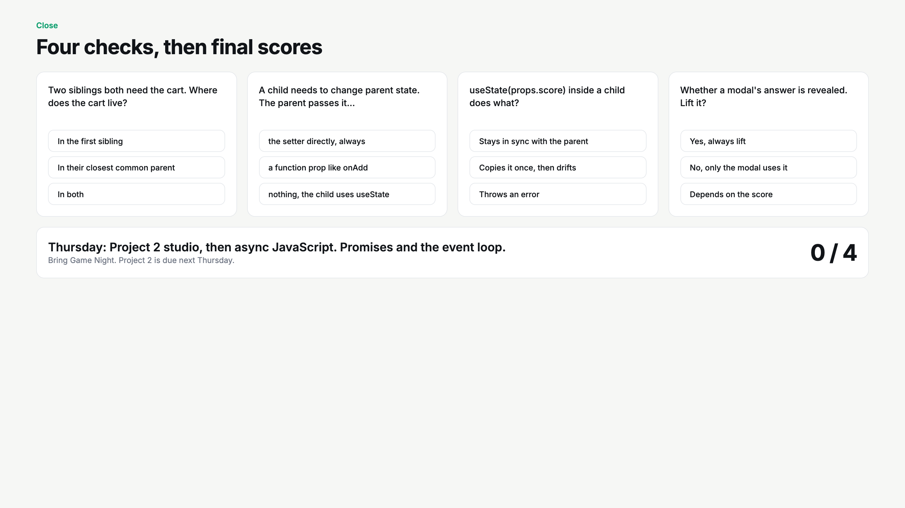
Notes:
Quiz, then go back to slide 2 and finish the board for final scores. Gold finishers add 500 to their team.

